Slide 1
IP Address

Slide 2
Addressing Overview
There are four addressing methods:
Data link layer MAC (Media Access Control) address is 48 bits, written as six hex numbers separated by colons
It is also called a physical address
MAC addresses are embedded on every NIC in the world
Network layer IP (Internet Address) address can be used to find any computer in the world
IPv4 addresses have 32 bits and are written as four decimal numbers called octets
IPv6 addresses have 128 bits and are written as eight blocks of hexadecimal number
Transport layer port numbers are used to find applications
Application layer FQDNs, computer names, and host names
Fully qualified domain name (FQDN) – a unique character-based name

Slide 3
MAC Addresses (1 of 2)
Traditional MAC addresses contain two parts
The first 24 bits are known as the OUI (Organizationally Unique Identifier) or manufacturer-ID
This part is assigned by the IEEE
The last 24 bits make up the extension identifier or device ID
Manufacturer’s assign each NIC a unique device ID
Switches use MAC addresses to identify devices on the local area network

Slide 4
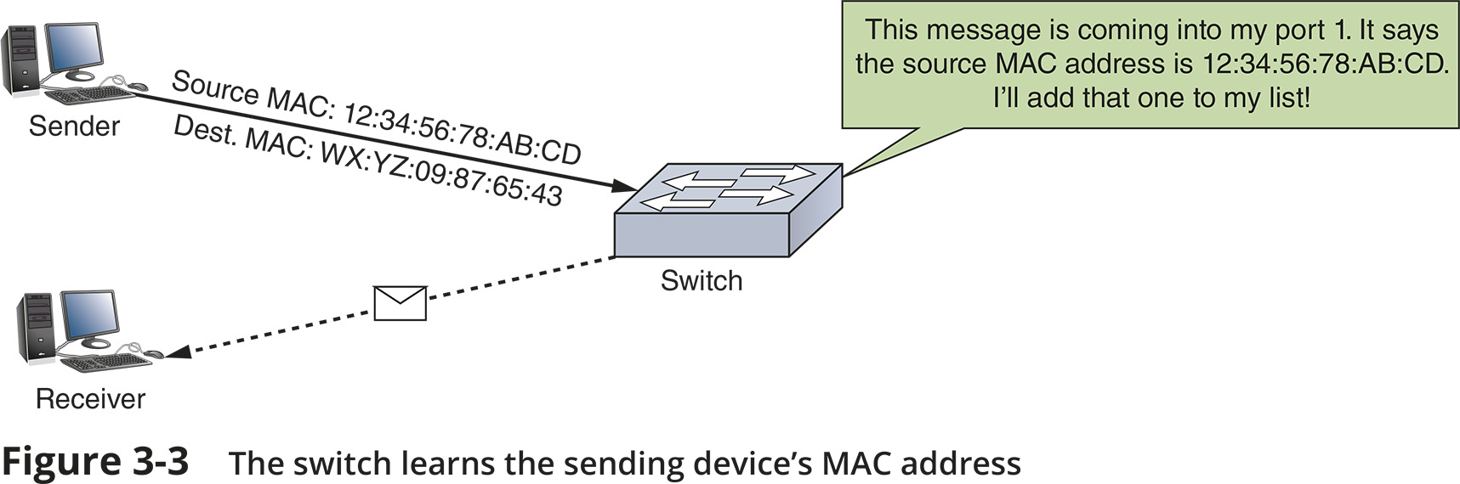
MAC Addresses (2 of 2)

Slide 5
IP Addresses
Static IP addresses are assigned manually by the network administrator
Dynamic IP addresses are automatically assigned by a DHCP server
You’ll learn more about DHCP later in the chapter
There are two types of IP addresses:
IPv4 is a 32-bit address
IPv6 is a 128-bit address

Slide 6
IPv4 Addresses (1 of 4)
A 32-bit IPv4 address is organized into four groups of 8 bits each (known as octets)
Each of the four octets can be any number from 0 to 255
Some IP addresses are reserved
Example of an IPv4 address: 72.56.105.12
Classful addressing
The dividing line between the network and host portions is determined by the numerical range the IP address falls in
Classful IPv4 addresses are divided into five classes:
Class A, Class B, Class C, Class D, and Class E

Slide 7
IPv4 Addresses (2 of 4)
Class A, B, and C licensed IP addresses are available for use on the Internet
These are called public IP addresses
A company can use private IP addresses on its private networks
The IANA recommends the following IP addresses be used for private networks:
10.0.0.0 through 10.255.255.255
172.16.0.0 through 172.31.255.255
192.168.0.0 through 192.168.255.255

Slide 8
IPv4 Addresses (2 of 4)
Classless addressing allows the dividing line between network and host portions to fall anywhere along the string of binary bits in an IP address
CIDR (Classless Interdomain Routing) notation takes the network ID or a host’s IP address and follows it with a forward slash (/) followed by the number of bits that are used for the network ID

Slide 9
IPv4 Addresses (3 of 4)
Network Address Translation (NAT) is a technique designed to conserve public IP addresses needed by a network
Address translation is a process where a gateway device substitutes the private IP addresses with its own public address
When these computers need access to other networks or Internet
Port Address Translation (PAT) is the process of assigning a TCP port number to each ongoing session between a local host and Internet host

Slide 10
IPv4 Addresses (3 of 4)
Two variations of NAT to be aware of:
SNAT (Source Network Address Translation) - the gateway assigns the same public IP address to a host each time it makes a request to access the Internet
DNAT (Dynamic Network Address Translation) - the gateway has a pool of public address that it is free to assign to a local host when it makes a request to access the Internet

Slide 11
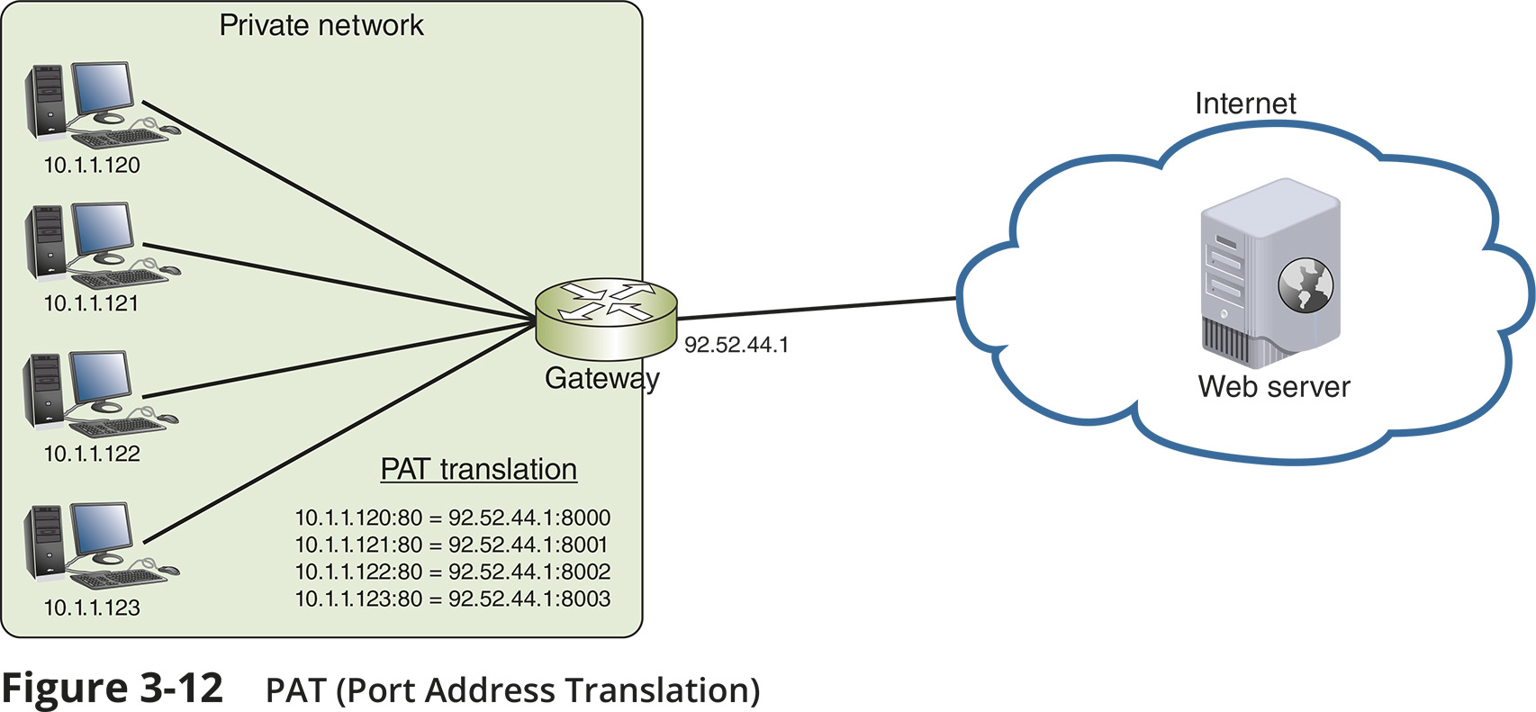
IPv4 Addresses (4 of 4)

Slide 12
IPv6 Addresses (1 of 2)
An IPv6 address has 128 bits written as eight blocks of hexadecimal numbers separated by colons
Ex: 2001:0000:0B80:0000:0000:00D3:9C5A:00CC
Each block is 16 bits
Leading zeros in a four-character hex block can be eliminated
If blocks contain all zeroes, they can be written as double colons (::), only one set of double colons is used in an IP address
Therefore, above example can be written two ways:
2001::B80:0000:0000:D3:9C5A:CC
2001:0000:B80::D3:9C5A:CC (this is the preferred method because it contains the fewest zeroes)

Slide 13
IPv6 Addresses (2 of 2)
IPv6 terminology:
A link (sometimes called local link) is any LAN bounded by routers
Neighbours are two or more nodes on the same link
Dual stacked is when a network is configured to use both IPv4 and IPv6
Tunnelling is a method used by IPv6 to transport IPv6 packets through or over an IPv4 network
Interface ID is the last 64 bits or four blocks of an IPv6 address that identify the interface

Slide 14
Types of IPv6 Addresses (1 of 4)
Unicast address - specifies a single node on a network
Global address can be routed on the Internet
Link local address can be used for communicating with nodes in the same link
Loopback address can be used to test that an interface and supporting protocol stack are functioning properly
Multicast address – delivers packets to all nodes on a network
Anycast address - can identify multiple destinations, with packets delivered to the closest destination

Slide 15
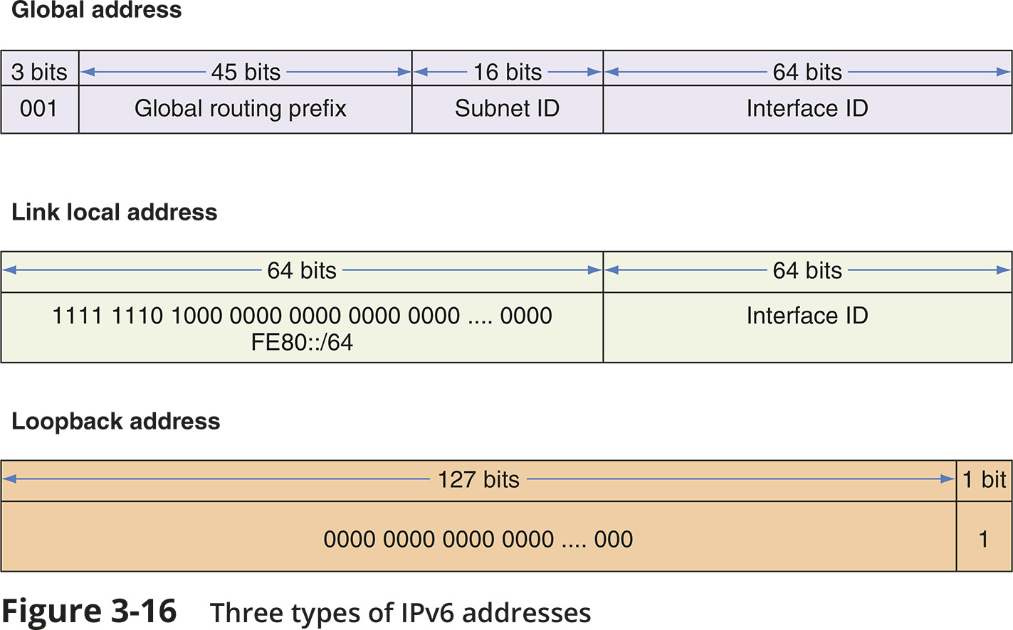
Types of IPv6 Addresses (2 of 4)

Slide 16
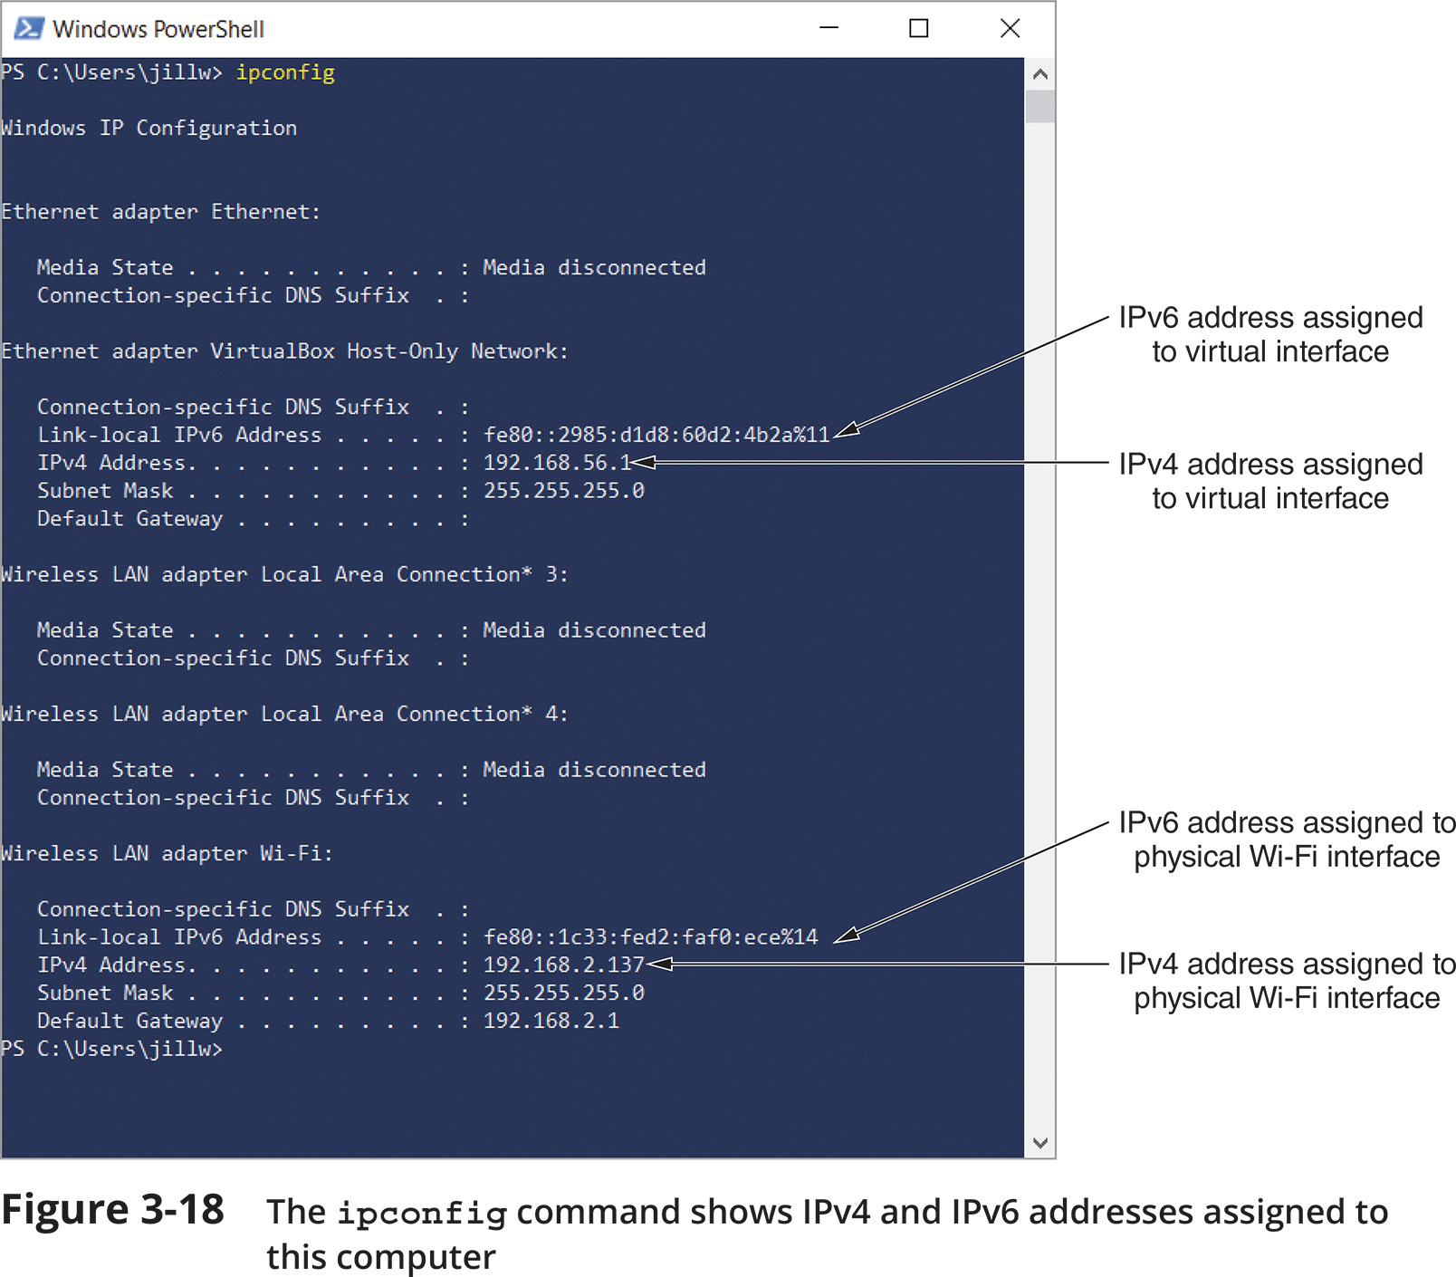
Types of IPv6 Addresses (3 of 4)

Slide 17
Types of IPv6 Addresses (4 of 4)
IPv6 autoconfiguration
IPv6 addressing is designed so that a computer can autoconfigure its own link local IP address
This process is called SLAAC (stateless address autoconfiguration)
Step 1 - The computer creates its IPv6 address
It uses FE80::/64 as the first 64 bits (called prefix)
The last 64 bits are generated from the network adapter’s MAC address
Step 2 - The computer checks to make sure its IP address is unique on the network
Step 3 - The computer asks if a router on the network can provide configuration information
This message is called an RS (router solicitation) message

